Slide 1

WALTON
Customer Driven
Marketing Strategy
Hi-Tech Industries PLC
A comprehensive analysis of segmentation, targeting, positioning,
marketing mix and strategic growth of Bangladesh's leading
electronics brand.

Slide 2


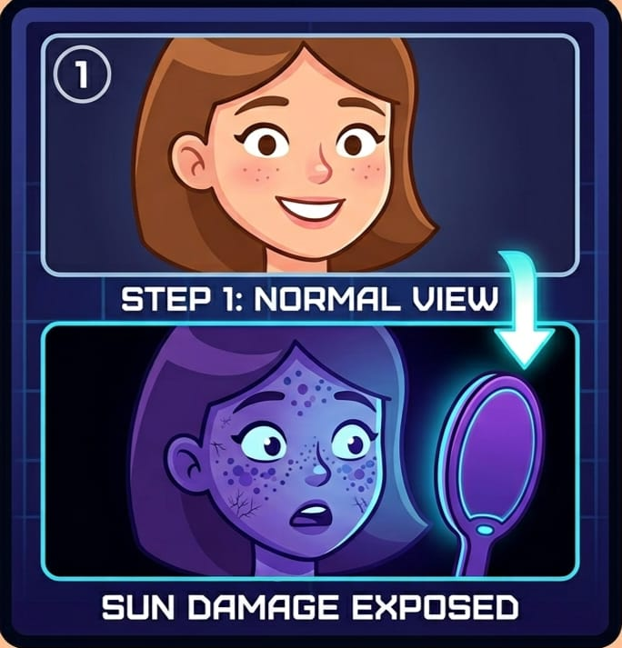

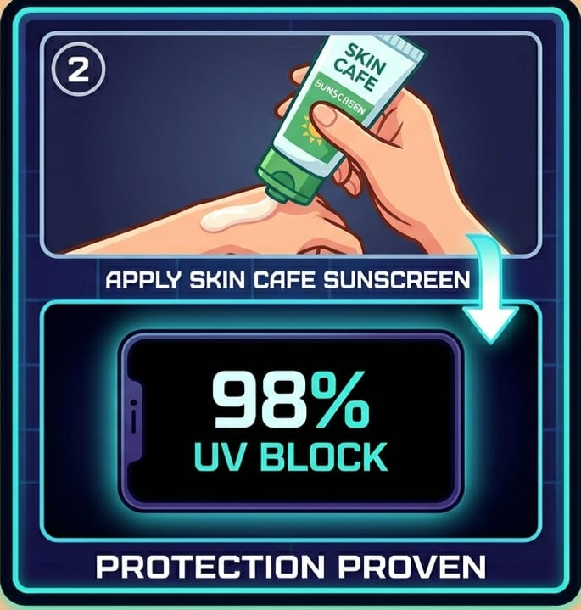
Campaign
Step 1 (Reveal): Bare face under UV mirror → hidden pigmentation & sun damage exposed.
Step 3 (Selfie & Capture): Take split-screen “before vs after” selfie
Step 2 (Protection): Apply Skin Cafe Sunscreen → screen shows it go completely black, proving 98% UV block.
Step 4 (Viral Loop):
Scan QR code → post to FB/IG with #SkinCafesuncheck #funfriday #beforevsafter #skincafe #seentheunseen + tag Skin Cafe to get digital photo.

Slide 3
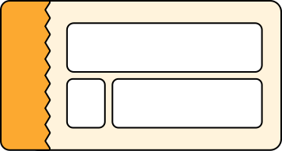
TEAM MEMBERS
Nasimul Hoque Nabil
Protik Sikder
ID:
2522219630
ID:
2524217630
Rafia Sanjana
Abdullah Muhammad Faisal
ID:
2531172630
ID:
2534227030

Slide 4
Outline of the Session
01
02
03
STP Analysis
Marketing Mix
Strategic Analysis
Briefing on how walton
segments, targets and
position ' s its business
model
How walton manages its
4 p ' s to provide superior
customer value
SWOT, Competitors and their
recent innitiative to make
the brand a better one

Slide 5
WALTON
Walton is one of the largest and leading electronics & electrical manufacturer in Bangladesh producing refrigerators, ACs, TVs, and home appliances. Walton is expanding both locally and globally with an 8% growth rate. Today our team will discuss about the ways how Walton grabs their consumer and uses marketing strategies to maintain their position as one of the leading manufacturer in Bangladesh eading

Slide 6
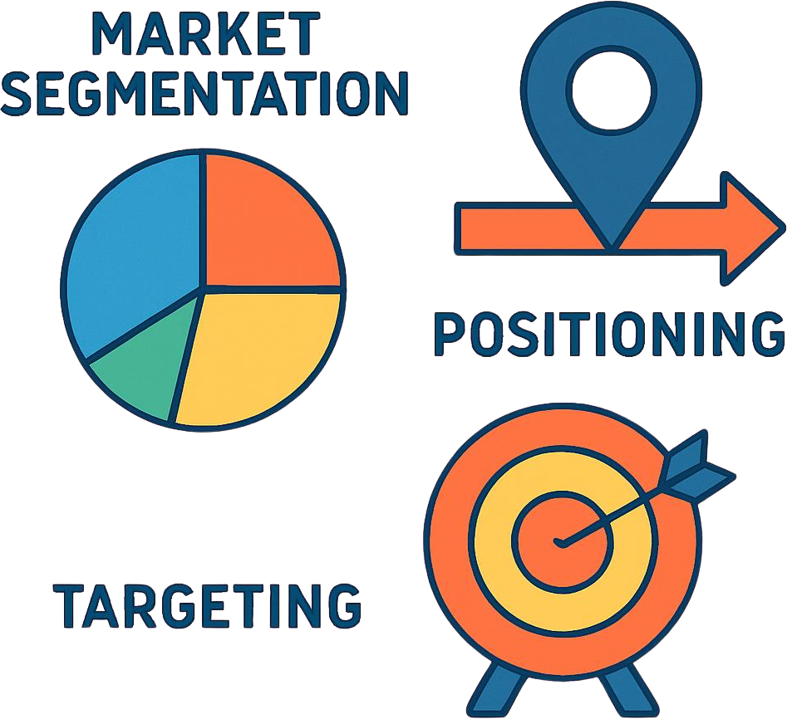
S.T.P Analysis
S.T.P
Walton's segmentation,
targeting and positioning their
brand in the market

Slide 7
Market sgmentation in which Walton operates
Geographic:
1. Walton is focusing on rural Bangladesh
2. Internationally expanding across Asia, Europe, Africa, Middle East
Demographic:
1. Walton divided the market into Premium, mid-range, and value- seeking consumers
2. Allows them to offer everything
Psychographic:
1. Walton focuses on Tech savvy users.
2. Also focuses on affordability of the customer
Behavioral:
1. Demand for modern design & features
2. Loyalty programs & distributor relationships

Slide 8
STP Analysis
Segmentation · Targeting · Positioning
TARGETING:
1. Walton focuses on middle income mass market
2. Targeting the Asian & global markets to build strong brand identity
POSITIONING
Smart Technology at Affordable Prices
Credibility-Driven Innovation
“Made in Bangladesh” Strength
Global quality + local market understanding
Cost reduction through vertical integration
Strong R&D investment
AI & IoT-based smart products
Builds trust & emotional connection
Competes with international brands

Slide 9
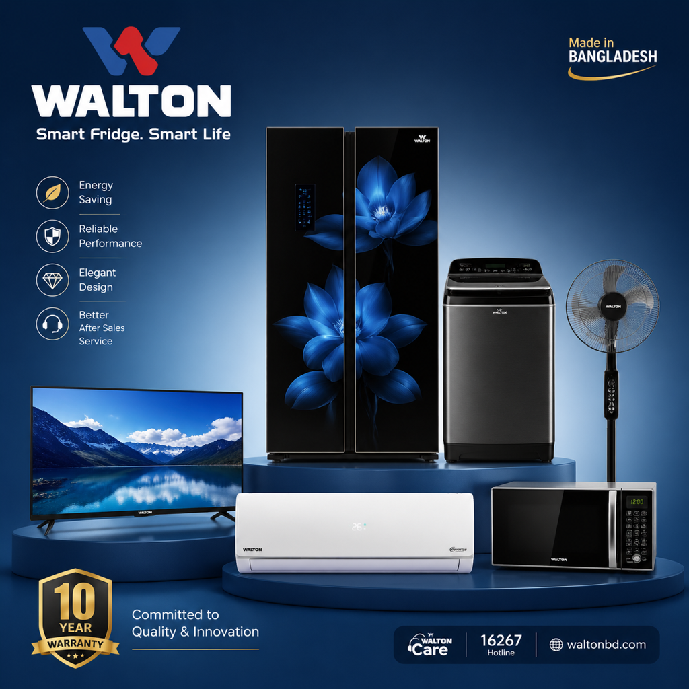
Marketing Mix
Product Strategy
Wide product range: fridge, TV, AC, smartphone, laptop
Focus on innovation & smart technology
Example: AI-powered smart refrigerator
Designed for local needs (e.g., larger freezer space
Pricing Strategy
💳
৳
🌐
Affordable & value-based pricing
Lower than global competitors
EMI / installment সুবিধা

Slide 10


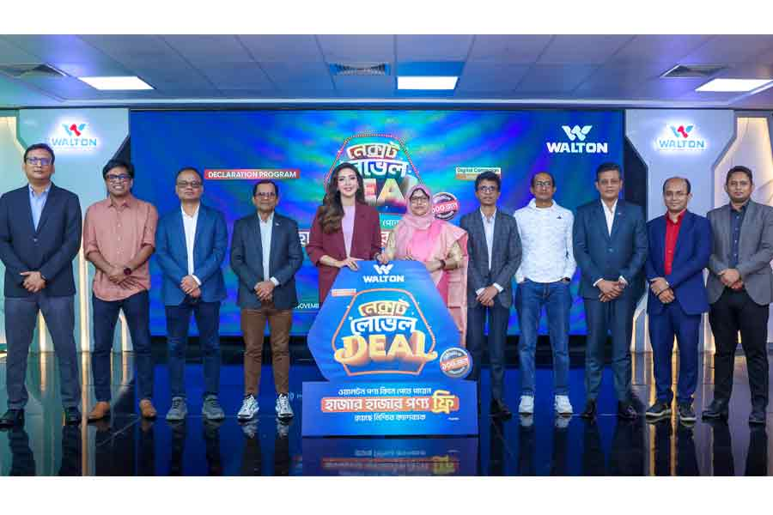
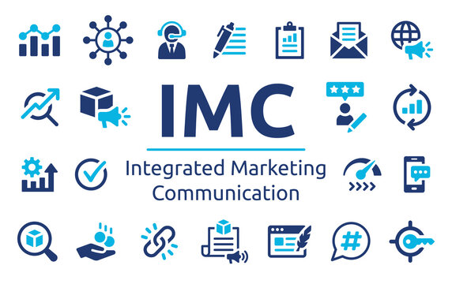
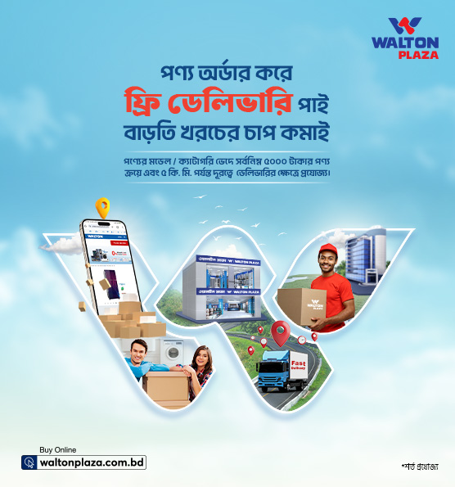


PROMOTION STRATEGY
Digital Campaigns
Celebrity Endorsement
Seasonal campaigns (S21–S24)
Large-scale consumer incentives
'Double Million' lottery offer
Win Tk 20 lakh (~$23,700 USD)
Mashrafe Bin Mortaza as brand ambassador
National cricket icon
Builds trust & pride
Wide consumer recognition
Integrated Marketing (IMC)
Digital Customer Database
All 6 IMC tools deployed
Advertising & sales promotions
Events, PR & digital media
Unified brand message
SMS & app product registration
Faster after-sales service
Targeted future promotions
Personalized communication

Slide 11
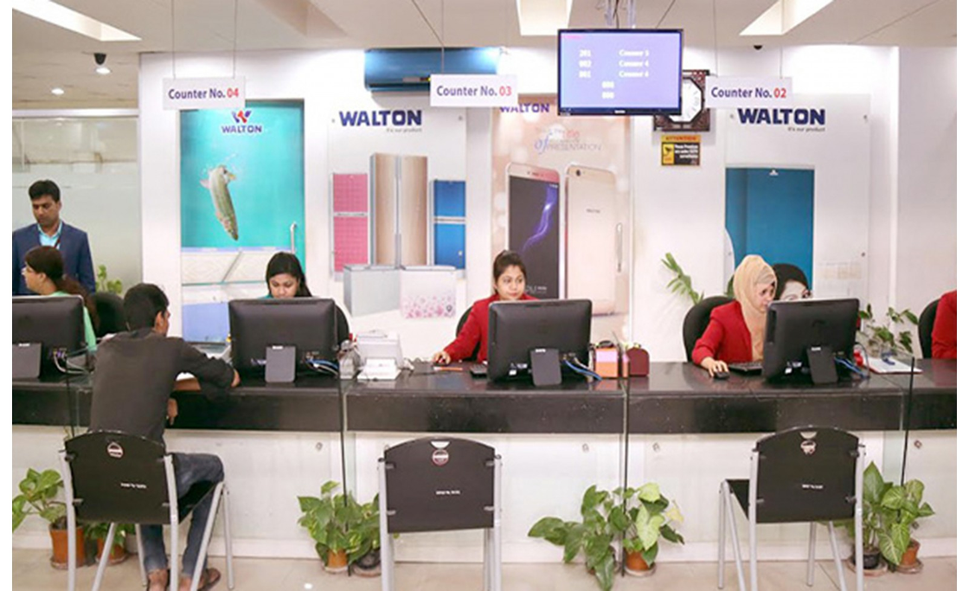
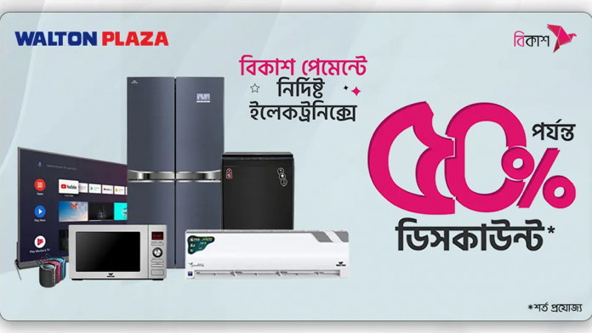
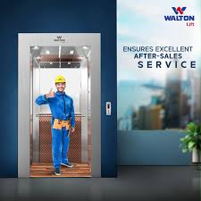

PLACE STRATEGY
Physical Retail Network
E-Commerce (E-Plaza)
Thousands of Walton Plaza showrooms
Franchise shops & exclusive distributors
Covers urban centers to rural upazilas
Nationwide coverage across Bangladesh
Own portal 'E-Plaza' + upgraded website
Special online-exclusive offers
Dedicated B2B & B2C platforms
Direct-to-consumer reach nationwide
After-Sales Service
Global Distribution
86+ ISO-certified service centers
Staffed by skilled engineers
12-year compressor warranty
1-year full replacement guarantee
Exports to 60+ countries worldwide
USA, UK, Germany & India included
International sales offices
Global distributorships network

Slide 12






MAJOR COMPETITORS
🏭 LOCAL COMPETITORS
🌍 GLOBAL COMPETITORS
Superstar Group
Samsung
29% share in electrical accessories
Strong global brand equity & advanced R&D
25.59% in lighting products
LG
Premium home appliances with global distribution
Vision (Pran-RFL)
Panasonic
Competes in home appliances
Established trust in electronics worldwide
Strong presence in urban markets
Philips
International presence in consumer electronics

Slide 13
Strategic Analysis
Ansoff Matrix
Market Penetration
• 25,000+ sales points across Bangladesh
• 700+ Walton Plaza showrooms
• Goal: retain & grow existing customer base
Product Development
AI & IoT integrated home appliances
Smart fridges with multimedia features
AI-based diagnostic systems

Slide 14
Strategic Analysis
Ansoff Matrix
Market Development
• 25,000+ sales points across Bangladesh
•Exporting to 50+ countries including India, Nepal, Turkey, Iraq, Nigeria, and Austria
• Target: 500,000 units exported annually by 2026
• Goal: Top 5 global electronics brand by 2030
Diversification
• New product lines: laptops, mobiles, PCBs, electric bikes
• Future plan: Electric vehicles (EVs

Slide 15

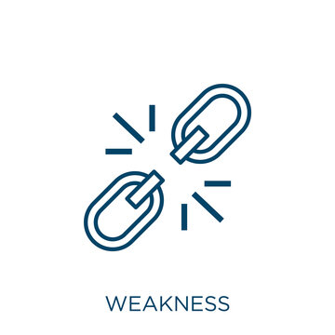


SWOT Analysis
Strengths · Weaknesses · Opportunities · Threats
STRENGTHS
WEAKNESSES
• Vertical integration > lower production costs
• Makes own compressors, molds & circuit boards
• 25,000 + sales points, 86 ISO-certified service centers
• High h brand equity (Best Enterprise
• Heavy dependence on Bangladeshi market Revenue tied to local economic conditions
• Perceived as "budget brand" by some premium urban customers
OPPORTUNITIES
THREATS
• Inflation & local currency devaluation squeezing margins
• Heavy spending by international competitors in Bangladesh
• Rapid tech obsolescence requires constant R&D investment
• Global demand for energy-efficient & eco-friendly products
•Growing demand in Africa, Middle East & EuropeGrowing demand in Africa

Slide 16
Conclusion
Walton Hi Tech Industries PLC has established itself as Bangladesh's leading electronics brand through smart pricing, vertical integration, and continuous innovation.
Walton's strength lies in its wide distribution network and strong brand loyalty. By continuing to invest in digitalization, product diversification, and global expansion, Walton is well-positioned for long-term success.

Slide 17



Thank You
for your time and attention

